Slide 1
The Great Canadian Land Grab
And the Plunder of Brant County

Slide 2
A brief history…
Landbanking has roots going all the way back to carpetbaggers in the Southern US in the 1800’s
Although considerably more sophisticated now, it appears to be no less damaging
It is still speculation!

Slide 3
A brief history…
Some governments have taken positive steps to “bank” land to preserve it against sprawl and uncontrolled development
  Saskatchewan 1972 (300,000 acres)

Slide 4
A brief history…
Why?
  Reduce urban decay/abandonment
  Reduce brownfields
  Encourage responsible development
  Reduce pressure on foodland
  Reduce speculation

Slide 5
Today…
Countries around the globe are facing “farmland grabs” by companies which purchase good farmland which appears to be in the path of development
Often funded by European, Asian and other foreign investors

Slide 6
Today…
By utilizing a dominant land ownership position in a given area, these companies are in a strong position to “pressure” zoning changes favorable to increasing land values and often reselling the land at greatly inflated prices

Slide 7
Today…
Often these companies present local governments with attractive “concept plans” which never come to pass
Or less frequently, these companies directly undertake development
Rarely are they interested in “used” land such as brownfields – they want only “raw” farmland

Slide 8
Today…
Countries around the world are struggling to manage this new and aggressive business model (United Kingdom, Australia)
GRAIN is an international NGO that tracks the global landgrab
http://formlandgrab.org

Slide 9
Walton in Ontario
Walton has become a major player in the landgrabbing business in Ontario
With its head office in Calgary, Walton claims to be a Canadian company however the majority of the funds it uses to further its business aims come from far east investors – Singapore and Malaysia

Slide 10
Walton in Ontario
Walton makes instant millionaires of local farmers, buying up farmland at high prices
Then the land is “syndicated” and shares sold to investors offshore
Walton manages extremely aggressive and active sales offices in Singapore and Malaysia

Slide 11
Walton in Ontario
At last (known) count, Walton had “syndicated” 87 projects in Ontario represented more than 12,900 acres of primarily foodland outside of Ontario greenbelts

Slide 12
Walton in Ontario
4,500 acres in Brant County
908 acres in Niagara
4,536 acres in Simcoe County
3,372 acres southwest of Ottawa
Notes:
March 5/13 Update from Jason Child, letter to Brant County Council. Walton now owns 4,500 acres in Brant County.

Slide 13
Walton in Ontario
From Walton sales literature
“We focus on acquiring a dominant land position in the market or sub-market to both identify and realize economies of scale and be considered as a recognizable stakeholder”
“The key to success in this business is to be an influential player – the dominant landowner in any given area”

Slide 14
Walton in Ontario
The business model appears to be successful –
  Walton has historically paid returns of approximately 22.80% for its investors – all without putting a shovel into the ground

Slide 15
Meanwhile, back on the farm…
Farmers who want to remain on the land face increasing pressure due to artificially inflated prices caused by speculation (and higher property values for property tax calculation)
Farmers faced with the spectre of industrial development in their back yards may not wish to remain on the land

Slide 16
Meanwhile, back on the farm…
Thus a race to the bottom begins
Impact on families
  Families have been torn apart as some wish to remain on heritage farms which have been in the family for generations; others see the shiny profits

Slide 17
Meanwhile, back on the farm…
Municipalities are losing successful heritage farms and vast tracts of foodland, while brownfields sit empty
Meanwhile a new kind of slum develops on the farmlands which are purchased for speculation – AGRISLUMS….
By extension, all of Ontario is paying the price for this kind of land speculation

Slide 18
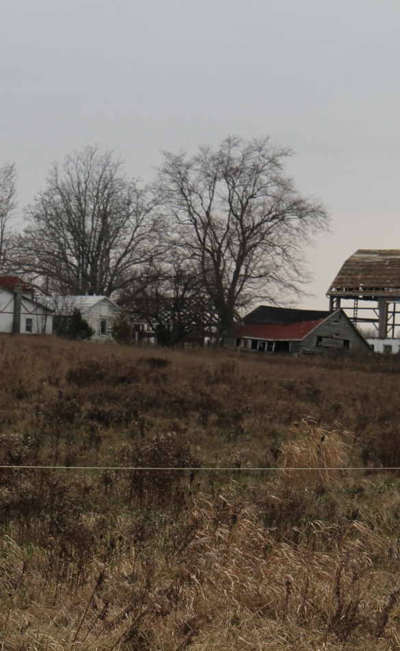
An example of a Langford agrislum owned by Walton

Slide 19
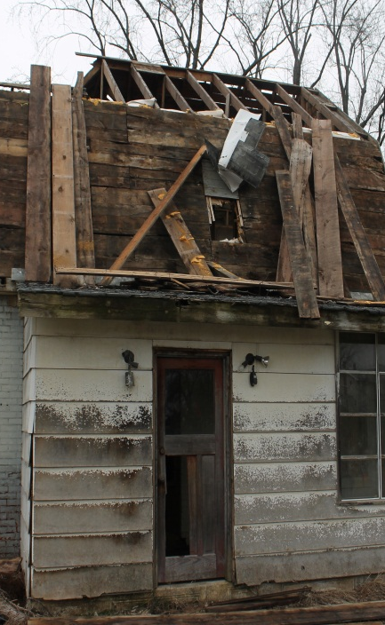
After complaints from citizens, many of these once productive farms were bulldozed by Walton subsidiaries

Slide 20
And in County Council…
Ontario municipal governments have had to utilize precious taxpayer dollars in defense costs at the Ontario Municipal Board OR
They see the cost of an OMB defense as too prohibitive and simply cave to the pressure of the developers against the wishes of the voters

Slide 21
Resources
With long term plans for a potential pipeline from Lake Erie to service development all the way from York and Caledonia through to Kitchener Waterloo, one has to question the sustainability of this kind of…
      S P R A W L

Slide 22
Resources
Walton describes itself as a $3.2 billion dollar company
What municipality or citizens group has the resources to stand up to this kind of juggernaut?

Slide 23
Walton in Ottawa
3,174 acres southwest of Ottawa with massive plans for a complete community to be built from scratch on prime farmland
Joined with a number of developers and builders in an appeal to the OMB concerning the City of Ottawa official plan

Slide 24
Walton in Ottawa
Although not successful this time, Walton has indicated it is coming back for another round
  “The partnership will focus its efforts on its continued participation in the 2014 Official Plan review process to support and possible the Ottawa lands in any expansions to Ottawa’s urban boundary”

Slide 25
Walton in Niagara
Walton owns 909 acres of farmland in Niagara
Walton unsuccessfully attempted to obtain an amendment to the Niagara Regional Plan for an urban boundary expansion on both sides of the QEW, from the current boundary of Niagara Falls through to Fort Erie

Slide 26
Walton in Niagara
“It is anticipated that future development of the lands will focus on residential lifestyle communities that may combine recreational and urban agricultural land uses. Area studies for all Walton lands in the Niagara region are ongoing”

Slide 27
Walton in Simcoe
Similar to their activities in Brant, Walton spent a number of years quietly purchasing farmland in the Simcoe area
Their coming out party (introduction to Council) did not occur until they had amassed 3.5% of the entire land mass of the County

Slide 28
Walton in Brant
In much the same way, Walton did not meet with municipal officials until after it had acquired an ownership position exceeding 6% (4000 acres) of all lands within the County

Slide 29
Walton in Brant
Walton is not alone in its landgrabbing in Brant County
  Hopewell
  First Urban
  Empire Communities
Have all been active in buying up farmlands throughout this primarily agricultural community

Slide 30
Walton in Brant
Three parcels:
  Blue Lake Road – approximately 3500 acres
    Future use unknown
  Tutela Heights – approximately 200 acres
    Compact residential
  Langford – 627 acres
    Industrial/commercial
  All these parcels are primarily farmland

Slide 31
Walton in Brant
In the Tutela Heights area, Walton proposes to install an 8 acre sewage treatment system (huge septic) on agricultural lands
A concept plan for this county block shows a projected total population of 8,819 residents where now only several hundred live
Notes:
The "Tutela Heights Community Concept Plan" from Sept. 24, 07...Request for area Study, Brad Rogers, Stantec. [in Brant County council package]. Potential Population is 2,756 units (8,819 pop.). That includes the existing population.

Slide 32
Walton in Brant
This area appears to be the starting point for Walton’s master plan for Brant County – with Tutela Heights being the residential area for the “employment opportunities” to be generated in the Langford farming community through industrial development

Slide 33
Walton in Brant
There is little doubt that the plans developed for both Tutela and Langford will destroy a way of life for hundreds of people, including loss of property values and significant loss of food producing lands
Both of these areas present significant wildlife habitat – which will be gone

Slide 34
Walton in Brant
Walton proposes to pump 133,690,000L of water per year from one end of the county to the Tutela area to support the first 200 homes
This is equivalent to 66 milk tankers PER DAY dumped on top of hard clay within one kilometer of the Grant River

Slide 35
Walton in Brant
The water taking area is populated with several beautiful farms
  A blueberry farmer next to the proposed wellhead indicates he fully expects to lose his farm once water taking begins

Slide 36
Walton in Brant
Walton has been frighteningly silent on its long term plans for the Blue Lake Road area
  Primarily rolling hills and beautiful farmland
  Rich aggregate area
  The Galt-Paris moraine sits under this land, making this an extremely environmentally sensitive area

Slide 37
Walton in Brant
The community of Langford has a rich history of dairy and mixed farming along Colborne Street East
This area abuts the provincial greenbelt just to the west of Ancaster and thus is truly attractive for “leapfrog” development

Slide 38
Walton in Brant
Following an extremely flawed “consultation process” Walton rolled out maps for the Langford area which showed industrial/commercial development over lands that are (a) currently farmed and (b) not owned by Walton

Slide 39
Walton in Brant
There is a growing farm movement in Langford that includes smaller and organic farms
  The high price Walton pays for farmland is making it increasingly difficult for these remaining farmers

Slide 40
What’s driving the Brant Pressure?
Developers have been lobbying to see the proposed Highway 424 (Brantford to Cambridge transportation corridor) meet at Jerseyville Road in Langford (where Walton’s parcels exist)
There is very little traffic on Jerseyville Road presently; an interchange on this road will likely accelerate the conversion from agriculture to industrial

Slide 41
What’s driving the Brant Pressure?
Walton may also be positioning itself for the proposed “superhighway” which is planned to connect Niagara to the GTA

Slide 42
Walton in Ontario
In Tutela Heights, Walton purchased a farm through 1664531 Ontario Inc. for $2.2-million in 2006
Then transferred the property to Walton Tutela Heights Corporation and Walton Tutela Heights Ontario Limited Partnership.
In 2010, the property was resold for $18-million to two other Walton subsidiaries, Riverbend Asset Management Corporation and Brant County Riverbend Development LP.
Notes:
[e1] [e1] Parcel Register 32067-0056Pt. Stewart and Ruggles Tract, Brantford, Pt. 1, 2R821 S/T A84678, TB 41204, County of Brant, Land Registry Office #2, Retrieved May 22, 2012.

Slide 43
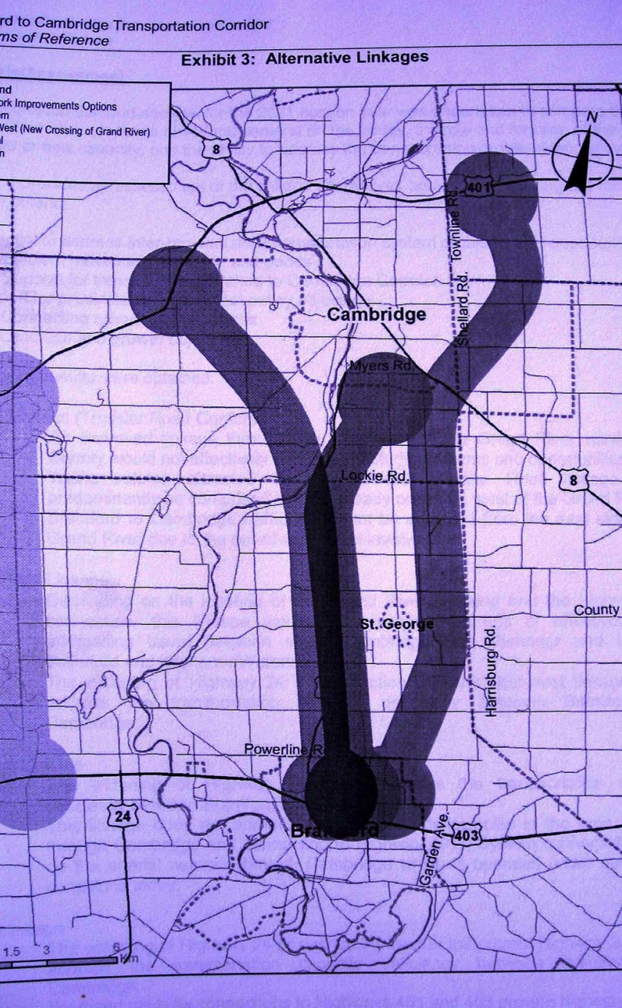
A new superhighway…

Slide 44
What can be done?
Make it less costly for municipalities to defend their official plans at the OMB
An existing OMB decision allows municipalities to decline 3P sewage and water systems – ensure this decision is not overturned
Legislate against offshore investment in Ontario farmland

Slide 45
What can be done?
Replicate other jurisdiction’s models to preserve and protect farmland and avoid sprawl
Investigate and support best practices for protection of farmland
Support farm co-operatives and small scale and organic farming as well as local food procurement by institutions

Slide 46
What can be done?
Prioritize redevelopment of greyfields and brownfields
Support cities to grow “up” not “out”
Change the rules for growing the greenbelt – allow citizens and NGO’s to petition
Legislate development “moratorium” on foreign owned farmland to reduce investment attractiveness

Slide 47
What can be done?
Work with First Nations communities to settle land claims – many of these communities have a vested interest in protecting foodland and the environment

